Slide 1
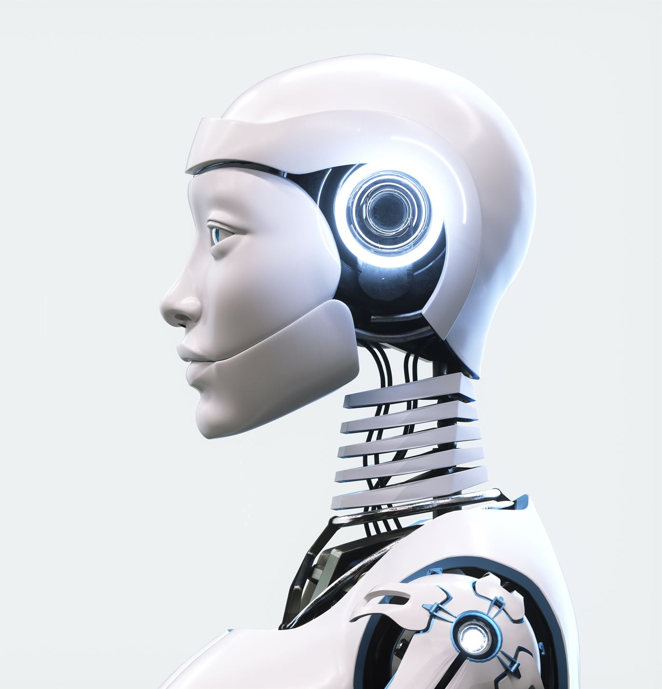

AI’s impact on employment and job displacement
Conclusion:
-It has been theorized that the current rise of AI is similar to past technological revolutions, much like the Industrial Revolution, the arrival of computers, or the internet. The rise of AI can present both new opportunities and challenges for the labour market.
-But just like previous revolutions, history has shown us that humans have the capacity to rise above initial disturbances and adapt to the new reality, through creating new industries, redefining job roles, and boosting innovation and economic growth.
-The labour market is adapting, and workers may need to develop new skills to remain competitive in this evolving landscape. The best outcome may be a human-AI collaboration, like the use of AI as a tool to enhance humans, not replace them.
Notes:
Image source: Microsoft 365 content library The rise of artificial intelligence is often compared to major technological shifts like the Industrial Revolution, the computer age, and the internet era. AI introduces transformative opportunities such as increased efficiency and innovation. However, it also presents challenges for the labor market, including job displacement and the need for new skills.

Slide 2
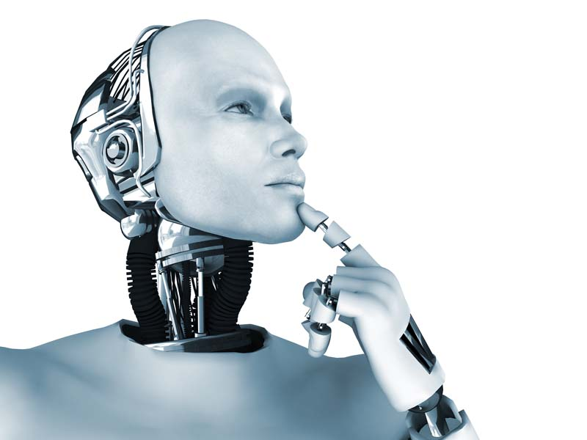
Final thoughts: Peer engagement question
“What are you most excited or concerned about, regarding AI and the labour market and why?”
We hope you enjoyed our presentation! Thank you!

